Slide 1

BIG DATA
Big Data Algorithm Complexity
K V Subramaniam
Computer Science and Engineering

Slide 2

BIG DATA
Overview of lecture
Motivation – Algorithm complexity
Communication Cost Complexity Model
3 Way joins with the communication cost complexity
Key parameters
Similarity join - analysis

Slide 3
Motivation – Algorithm Complexity

Slide 4
BIG DATA
Why Study complexity?
So far, we have looked at MapReduce algorithms
However, for a particular problem, there could be many algorithms
Which algorithm should we choose?
This is why we study complexity of MapReduce
We will actually study complexity of workflow systems
Generalization of MapReduce
Many important Big Data systems are workflow systems

Slide 5

BIG DATA
Exercise
Consider the following two problems
Matrix multiplication
Database query
What would be the complexity of these algorithms when executing on a single node?
What does complexity depend on?

Slide 6
BIG DATA
Solution: Class Exercise
Matrix multiplication
Expressed in terms of the bound on total #computations performed
Database query
Complexity depends on disk read

Slide 7
BIG DATA
Communication Cost Complexity
Communication cost: size of input
Why communication cost?
Algorithm tends to be linear in data
Network speed << CPU speed
Disk speed << CPU speed
Major time could be communication time

Slide 8
BIG DATA
Communication Cost Complexity
Why only input size?
Output is input to some other task
Final output is generally small by aggregation
Otherwise not human-readable

Slide 9
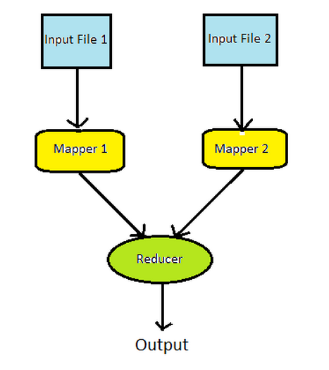
BIG DATA
Natural Join: join R, S
Mapper input complexity = r+s
Read data from disk
Reducer input complexity = r+s
Network reads
Total Complexity: O(r+s)

Slide 10
BIG DATA
Exercise – Join complexity
Consider three relations R, S and T
How will you perform a join using map reduce across the three?
Estimate the complexity

Slide 11
3 way join complexity

Slide 12
BIG DATA
3-way Join: R, S, T
2 MapReduce phases
Case 1: Join R,S and then join T
Input to Mapper 1: r
Input to Mapper 2: s
Input to Reducer 1: r+s
Let p be the probability of match between r,s
Input to Mapper 3: prs
Input to Mapper 4: t
Input to Reducer 2: t+prs
Total Complexity: O(r+s+t+prs)
Mapper R
Mapper S
Mapper T
Join R,S
Mapper R+S
Join R,S,T

Slide 13
BIG DATA
…3 Way Join R, S, T
Case 1: Join S,T and then join R
Input to Mapper 1: s
Input to Mapper 2: t
Input to Reducer 1: s+t
Let q be the probability of match between s,t
Input to Mapper 3: qst
Input to Mapper 4: r
Input to Reducer 2: r+qst
Total Complexity: O(r+s+t+qst)
Depends upon join order
If p~q, first join could be whichever of rs, st, rt is the smallest
Mapper R
Mapper S
Mapper T
Join S, T
Mapper S+T
Join R,S,T

Slide 14
Key performance parameters

Slide 15
BIG DATA
Wall Clock Time
Can make communication cost very low by executing all tasks on single CPU
However, program may run slowly
Need to consider wall clock time
Time taken for entire job to finish
Dividing jobs could increase communication but reduce wall clock tme
Need to trade off communication time, wall clock time

Slide 16
BIG DATA
Parameters: Wall Clock Time vs Communication cost
Reducer size q
Max # of values that can have the same key
Not the number of reducers
If q is small, there can be more reducers
Suppose the number of Map outputs is T
Max number of reducers = T/q
This will reduce the wall clock time
But increase the communication cost
Replication rate r
r = (#key value pairs output by Mapper) / (# input records to Mapper)
Average communication cost from Map tasks to Reduce tasks

Slide 17
Similarity Joins

Slide 18
BIG DATA
Wall Clock Example: Similarity Join Between Images
Assume we have a database of 1 million images
Each image is 1 MB
Total DB size = 1 TB
Assume there is a function s(x,y) which determines how similar two images x,y are
s(x,y) = s(y,x)
Problem: output all pairs x,y such that s(x,y) > t

Slide 19
BIG DATA
Naïve Algorithm for example
Assume each image P_{i} has an index i
Mapper
Reads in (i,P_{i})
Generates all pairs ({i,j},{P_{i} ,P_{j} })
Reducer
Reads ({i,j},{P_{i} ,P_{j} })
Computes s(P_{i},Pj)

Slide 20
BIG DATA
Exercise
What is the
Communication cost of the naïve algorithm?
Parallelism of the naïve algorithm?
What is the replication rate for the algorithm?

Slide 21
BIG DATA
Exercise - Solution
What is the
Communication cost of the naïve algorithm?
Parallelism of the naïve algorithm?
Algorithm doesn’t work
Data to be transmitted = 1,000,000 x 999,999 x 1,000,000 bytes = 10¹⁸
Communication cost is ~n² where n is the number of images (extremely high)
However, potential parallelism is very high
Reducer size is very high → since 10¹⁸ key value pairs are generated, each can be processed in parallel by a different reducer
Replication rate -> each piece of data copied 999,999 times, so huge amount of data copied.

Slide 22
BIG DATA
The other extreme
Do everything on one node
Mapper
Reads in (i,P_{i})
Generates all pairs ({i,j},{P_{i} ,P_{j} })
Reducer (runs on same node as mapper)
Reads ({i,j},{P_{i} ,P_{j} })
Computes s(P_{i},Pj)
No communication cost
Very low parallelism (wall clock time high)

Slide 23
BIG DATA
Summary
Send one pair to each reducer
Do everything on one node
High communication cost (bad)
High parallelism (good)
Low parallelism (bad)
Low communication cost (good)
Can we get something in between?

Slide 24
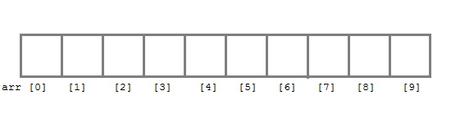
BIG DATA
Group-based algorithm
Overview
Group images
Read in two groups of images in a single reducer
Store them in memory
Compare all pairs from those groups
Output results
Reducer 1
Reducer 2

Slide 25
BIG DATA
Example: 100 Groups
Suppose the groups are G0, … G99
Group G0 is sent to nodes 0, 1, ..., 98
Why?
Group G0 has to be compared with 99 other groups
Group G1 is sent to?
0, 1, …, 98
Group G1 is sent to 0, 99, 100, ...196 (0+98 other nodes)
Group G2 is sent to?
Group G2 is sent to 1, 99, 197, 198, ... 293 (1, 99 +97 other nodes)
Group G3 is sent to 2, 100, 197, 294, ...389 (2, 100, 197, +96 other nodes)

Slide 26
BIG DATA
In General
If there are g groups
The number of images per group m=n/g
Each group is sent to g-1 servers
Total number of messages = g(g-1)
Total data = mg(g-1) = n(g-1) ~ ng
Parallelism = no of nodes = (g-1) + (g-2) + (g-3) + … = g(g-1)/2 =O( g²)
Another way = no of nodes = ^{n}C₂ =g(g-1)/2

Slide 27
BIG DATA
Exercise
Suppose we have groups of 100
How many groups are there?
How many nodes is each group sent to?
What is the
Communication cost of the algorithm?
Parallelism of the algorithm?

Slide 28
BIG DATA
…Group Based Algorithm…
Naïve: approximately 1,000,000x1,000,000 images = 10¹² images, parallelism = 10¹²
Example: group images into groups of100
Communication cost: 1,000,000 images x 100 groups = 10⁸ images
Parallelism = 10⁴ (100 groups compared with 99 other groups ~ 10⁴ )
Example: group images into groups of1000
Communication cost = 1,000,000 x 1000 = 10⁹ images
Parallelism = 10⁶
Trade-off: increasing group size
Increases communication complexity (more reads)
Reduces wall clock time (increases parallelism)
Notes:
No of groups = 10,000 for case where they are into groups of 100, Communication cost = 10,000*9999~ 10^8
No of groups = 1,000 for case where they are broken into groups of 1000

Slide 29
BIG DATA
…Group Based Algorithm
On next slide
Note
Group-based algorithm is discussed in book as if mapper sends pictures to reducer
In previous slides, we have discussed as if reducer reads in pictures from disk
From communication cost complexity both are the same
Performance: probably better to read from disk

Slide 30
BIG DATA
Group Based algorithm
Overview
Group images
Read in two groups of images in a single reducer
Store them in memory
Compare all pairs from those groups
Output results
Complexity
Communication cost ~ng where g is the number of groups
Can still get good parallelism

Slide 31
BIG DATA
Grouping images..
Group images into g groups
Mapper
Input: (i,P_{i} )
Find u = group to which image i belongs
Output g-1 key-value pairs ({u,v}, i,P_{i} ) for all v != u
Reducer:
There is one reducer for each unique key {u,v}
Use the input to store images for groups u,v
Compare all pairs of images in groups u,v
If v=u+1, then compare all pairs of images in group u

Slide 32
BIG DATA
Actual Values
If group size is 1000
Need ~2GB to store 2000 images in memory
Need ~500,000 reducers
If we have a 10,000 node cluster
Can do computation in 50 passes
Speedup of 10,000

Slide 33
BIG DATA
Summary
There could be many MapReduce algorithms to implement a particular functionality
Matrix multiplication
Multi-way joins
There are two factors to consider when selecting an algorithm
Communication complexity: volume of data that is input to the different phases of the algorithm
Wall clock time: Total elapsed time for algorithm
Depends upon parallelism
Frequently there is a trade-off between these factors
Group size

Slide 34
BIG DATA
References
Mining of Massive Datasets
Rajaraman et. Al.
Chapter 2.4-2.5

Slide 35
THANK YOU
K V Subramaniam, Usha Devi
Dept. of Computer Science and Engineering
subramaniamkv@pes.edu
ushadevibg@pes.edu

